Slide 1
UNIT VI
WWW & HTTP
WAP

Slide 2
27-1 WWW ARCHITECTURE
World Wide Web (WWW) is a repository of information linked together from points all over the world.
The WWW has a unique combination of flexibility, portability, and user-friendly features that distinguish it from other services provided by the Internet.
The WWW project was initiated by CERN to create a system to handle distributed resources necessary for scientific research

Slide 3
27-1 WWW ARCHITECTURE
The WWW today is a distributed client/server service, in which a client using a browser can access a service using a server. However, the service provided is distributed over many locations called sites.
Topics discussed in this section:
Client (Browser) Server Uniform Resource Locator
Cookies

Slide 4
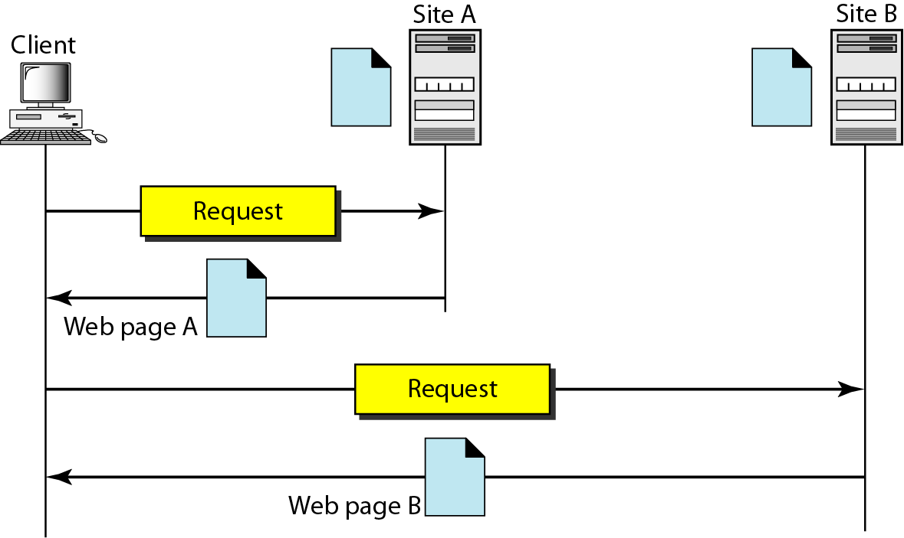
Figure 27.1 Architecture of WWW

Slide 5
Each site holds one or more documents, referred to as Web pages.
Each Web page can contain a link to other pages in the same site or at other sites.
The pages can be retrieved and viewed by using browsers.
For Example : client needs to see some information that it knows belongs to site A.
It sends a request through its browser, a program that is designed to fetch Web documents.
The request, among other information, includes the address of the site and the Web page, called the URL.
The server at site A finds the document and sends it to the client. When the user views the document, she finds some references to other documents, including a Web page at site B.
The reference has the URL for the new site.
The user is also interested in seeing this document.
The client sends another request to the new site, and the new page is retrieved.

Slide 6
Client (Browser)
A variety of commercial browsers are available that interpret and display a Web document.
Each browser usually consists of three parts:
controller
client protocol
interpreters

Slide 7
Controller
The controller receives input from the keyboard or the mouse and uses the client programs to access the document.
After the document has been accessed, the controller uses one of the interpreters to display the document on the screen.
The client protocol can be protocols like FTP or HTTP.
The interpreter can be HTML, Java, or JavaScript, depending on the type of document.

Slide 8
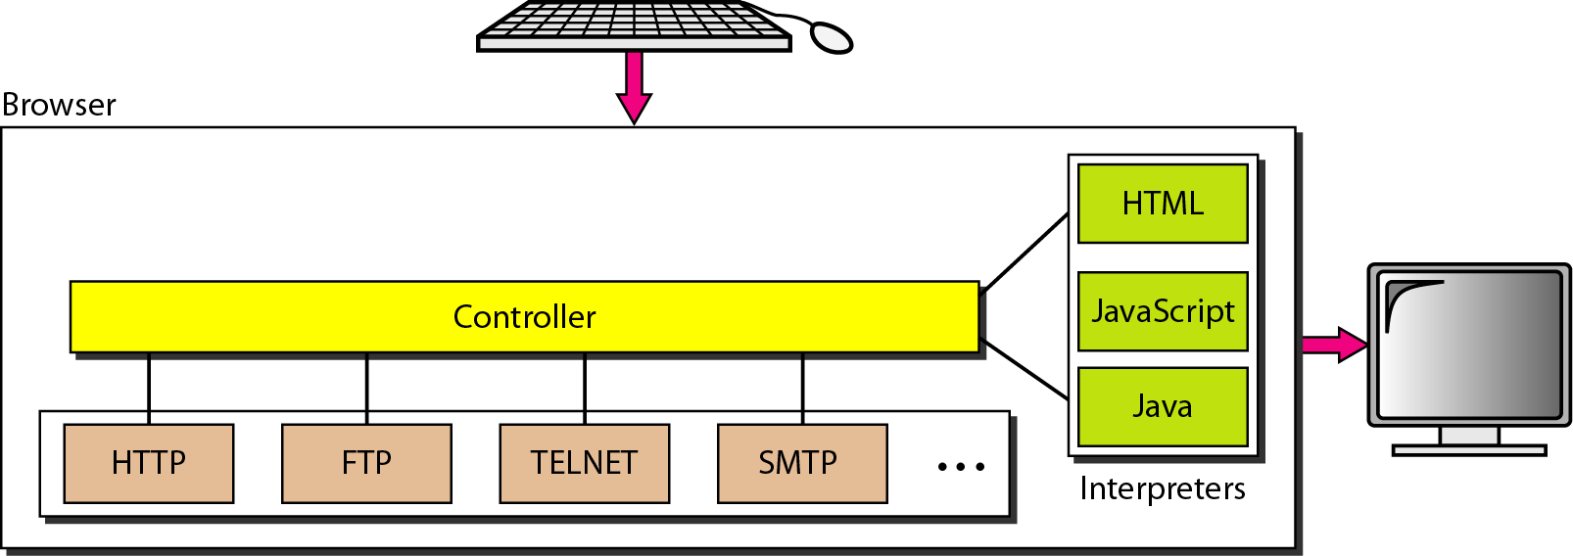
Figure 27.2 Browser

Slide 9
Server
The Web page is stored at the server. Each time a client request arrives, the corresponding document is sent to the client.
To improve efficiency, servers normally store requested files in a cache in memory; memory is faster to access than disk.
A server can also become more efficient through multithreading or multiprocessing where the server can answer more than one request at a time.

Slide 10
Uniform Resource Locator
A client that wants to access a Web page needs the address
To access the documents distributed throughout the world, HTTP uses locators.
The uniform resource locator (URL) is a standard for specifying any kind of information on the Internet.
URL defines four things:
Protocol
host computer
Port
path

Slide 11
Figure 27.3 URL

Slide 12
The protocol is the client/server program used to retrieve the document. Eg: FTP, HTTP.
The host is the computer on which the information is located, the name of the computer can be an alias.
Host can be any name given to the computer that hosts the Web page. (optionally begins with www)
The URL can optionally contain the port number of the server. If the port is included, it is inserted between the host and the path, and it is separated from the host by a colon.
Path is the pathname of the file where the information is located. Note that the path can itself contain slashes to separate the directories from the subdirectories and files.

Slide 13
Cookies- Creation and Storage of Cookies
Steps involved n creation and storage of Cookies
When a server receives a request from a client, it stores information about the client in a file or a string. The information may include the domain name of the client, the contents of the cookie, a timestamp, and other information depending on the implementation.
The server includes the cookie in the response that it sends to the client.
When the client receives the response, the browser stores the cookie in the cookie directory, which is sorted by the domain server name.

Slide 14
Using Cookies
When a client sends a request to a server, the browser looks in the cookie directory to see if it can find a cookie sent by that server.
If found, the cookie is included in the request. When the server receives the request, it knows that this is an old client, not a new one.
Note that the contents of the cookie are never read by the browser or disclosed to the user. It is a cookie made by the server and eaten by the server.

Slide 15
Cookies Usage Case Scenarios
Scenario 1 Site services available to only registered users.
The site that restricts access to registered clients only sends a cookie to the client when the client registers for the first time.
For any repeated access, only those clients
that send the appropriate cookie are allowed.

Slide 16
Cookies Usage Case Scenarios
Scenario 2 :
An electronic store (e-commerce) can use a cookie for its client shoppers. When a client selects an item and inserts it into a cart, a cookie that contains information about the item, such as its number and unit price, is sent to the browser.
If the client selects a second item, the cookie is updated with the new selection information and so on.
When the client finishes shopping and wants to check out, the last cookie is retrieved and the total charge is calculated.

Slide 17
Cookies Usage Case Scenarios
Scenario 3 :
A Web portal - When a user selects her favorite pages, a cookie is made and sent. If the site is accessed again, the cookie is sent to the server to show what the client is looking for.

Slide 18
Cookies Usage Case Scenarios
Scenario 4 :
Used by advertising agencies. An advertising agency can place banner ads on some main website that is often visited by users.
The advertising agency supplies only a URL that gives the banner address instead of the banner itself. When a user visits the main website and clicks on the icon of an advertised corporation, a request is sent to the advertising agency.

Slide 19
Cookies Usage Case Scenarios
Scenario 4 continuation:
The advertising agency sends the banner, a GIF file, for example, but it also includes a cookie with the will of the user.
Any future use of the banners ads to the database that profiles the Web behavior of the user.
The advertising agency has compiled the interests of the user and can sell this information to other parties. This use of cookies has made them very controversial.
Hopefully, some new regulations will be devised to preserve the privacy of users.

Slide 20
27-2 WEB DOCUMENTS
The documents in the WWW can be grouped into three broad categories: static, dynamic, and active. The category is based on the time at which the contents of the document are determined.
Topics discussed in this section:
Static Documents
Dynamic Documents Active Documents

Slide 21
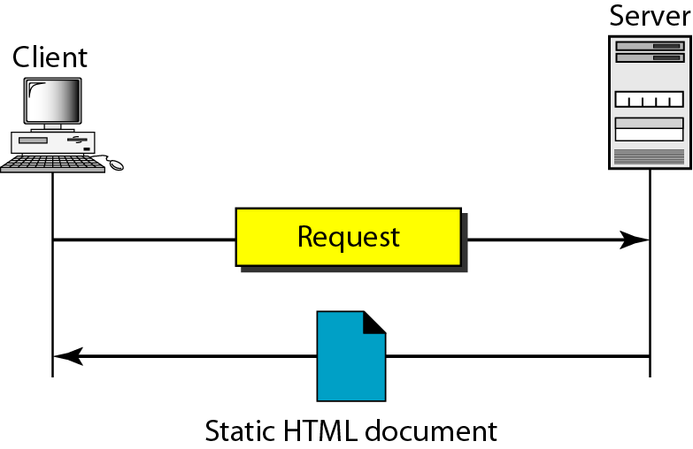
Figure 27.4 Static document

Slide 22
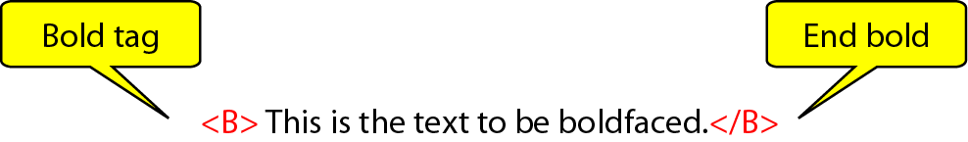
Figure 27.5 Boldface tags

Slide 23
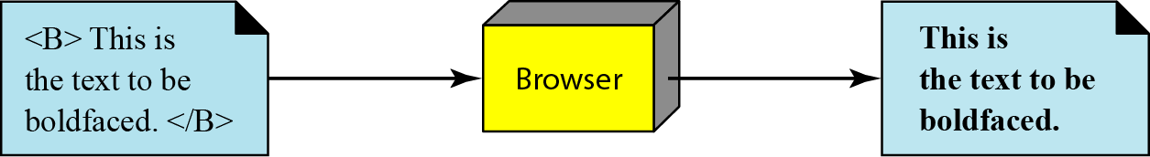
Figure 27.6 Effect of boldface tags

Slide 24
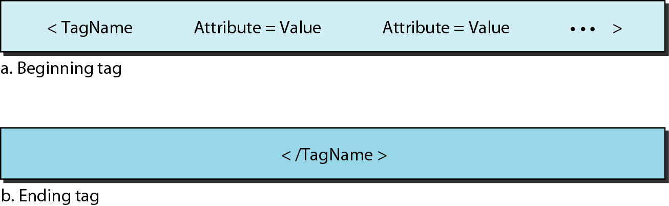
Figure 27.7 Beginning and ending tags

Slide 25
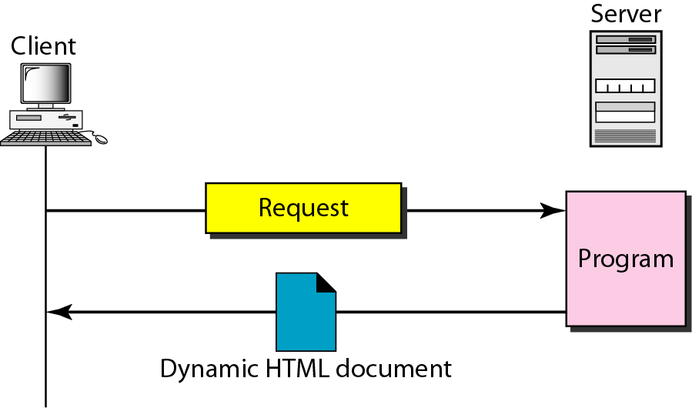
Figure 27.8 Dynamic document using CGI

Slide 26
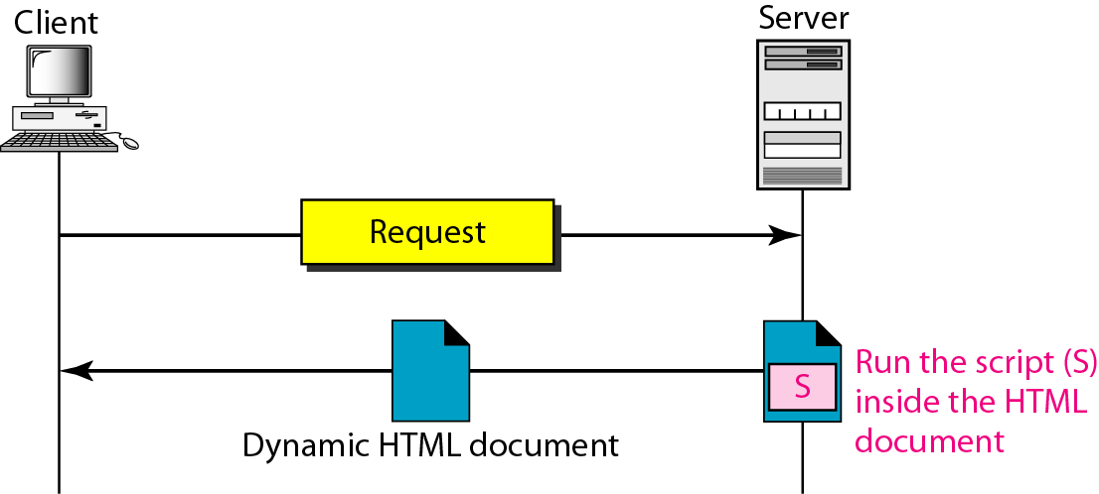
Figure 27.9 Dynamic document using server-site script

Slide 27

Note
Dynamic documents are sometimes referred to as server-site dynamic documents.

Slide 28
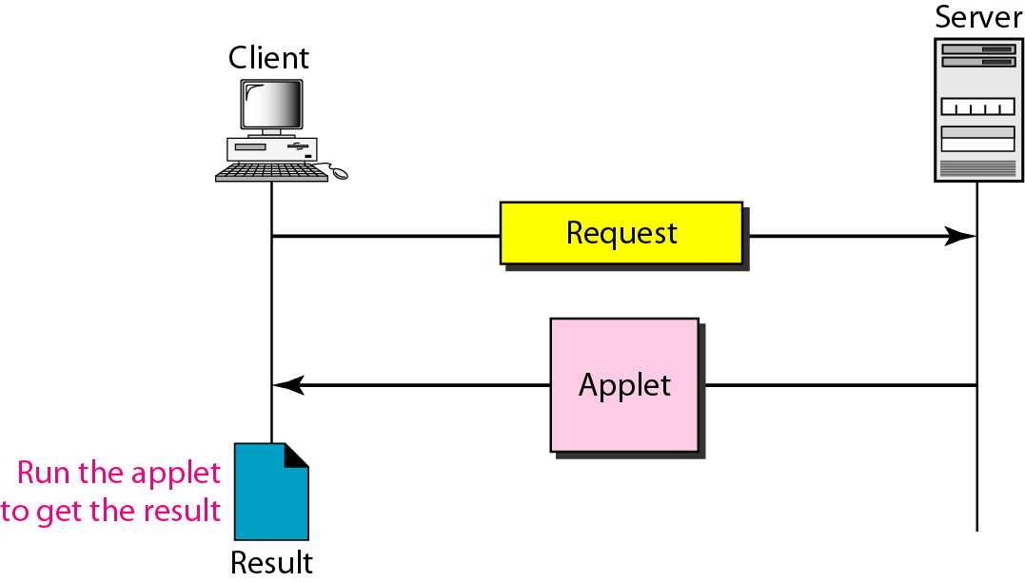
Figure 27.10 Active document using Java applet

Slide 29
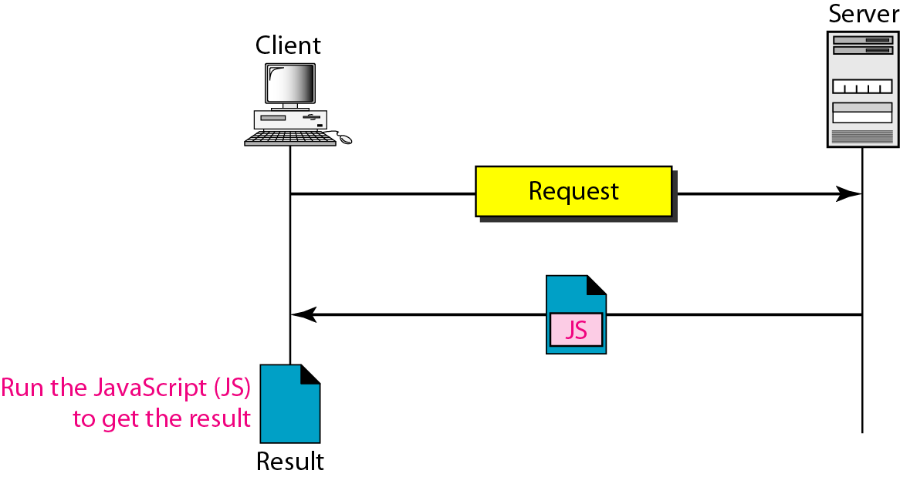
Figure 27.11 Active document using client-site script

Slide 30
Note
Active documents are sometimes referred to as client-site dynamic documents.

Slide 31
27-3 HTTP
The Hypertext Transfer Protocol (HTTP) is a protocol used mainly to access data on the World Wide Web. HTTP functions as a combination of FTP and SMTP.
Topics discussed in this section:
HTTP Transaction Persistent Versus Nonpersistent Connection

Slide 32
HTTP & FTP :
HTTP is similar to FTP because it transfers files and uses the services of TCP.
It is much simpler than FTP because it uses only one TCP connection.
There is no separate control connection, only data are transferred between the client and the server.

Slide 33
HTTP & SMTP :
HTTP is like SMTP because the data transferred between the client and the server look like SMTP messages.
In addition, the format of the messages is controlled by MIME-like headers.
Unlike SMTP, the HTTP messages are not destined to be read by humans; they are read and interpreted by the HTTP server and HTTP client (browser).

Slide 34
HTTP & SMTP :
SMTP messages are stored and forwarded, but HTTP messages are delivered immediately.
The commands from the client to the server are embedded in a request message.
The contents of the requested file or other information are embedded in a response message. HTTP uses the services of TCP on well-known port 80.

Slide 35
Note
HTTP uses the services of TCP on well-known port 80.

Slide 36
HTTP Transaction
The HTTP transaction is in between the client and server.
Although HTTP uses the services of TCP, HTTP itself is a stateless protocol.
The client initializes the transaction by sending a request message.
The server replies by sending a response.

Slide 37
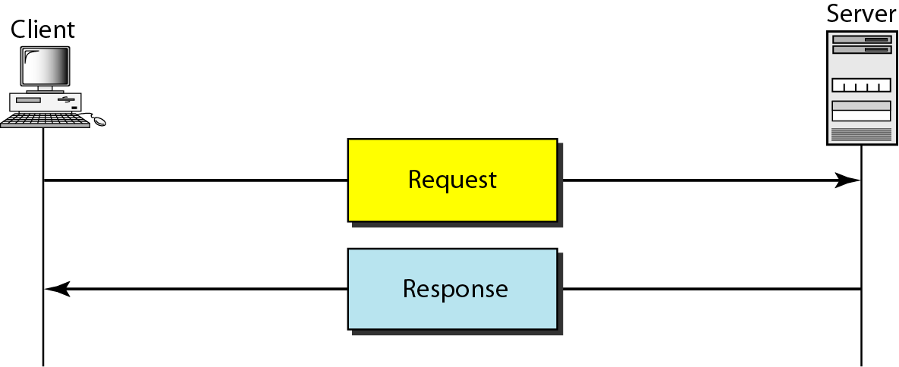
Figure 27.12 HTTP transaction

Slide 38
Messages
The formats of the request and response messages are similar
A request message consists of
request line
header
body (optional)
A response message consists of
status line
header
body(optional)

Slide 39
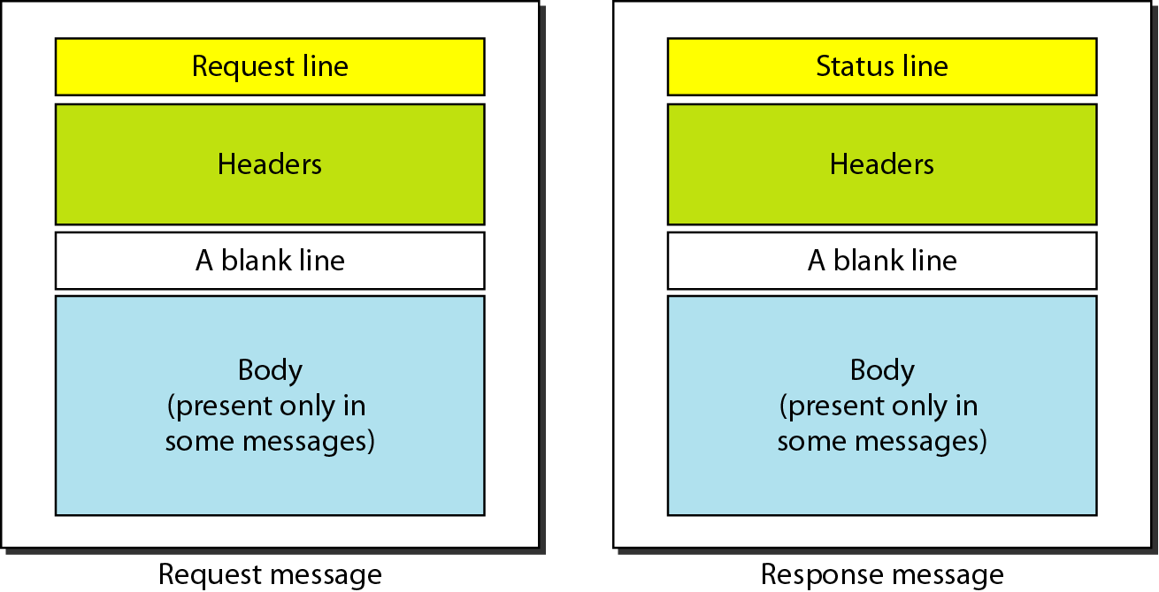
Figure 27.13 Request and response messages

Slide 40
Request and Status Lines:
The first line in a request message is called a request line.
The first line in the response message is called the status line.
There is one common field

Slide 41
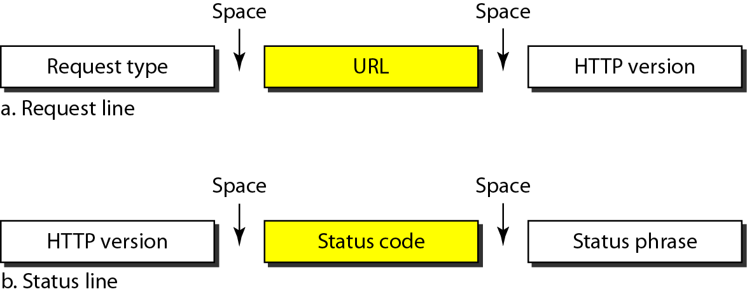
Figure 27.14 Request and status lines

Slide 42
Request line contains the following:
Request type: This field is used in the request message. several request types are defined in HTTP. The request type is categorized into methods as defined in Table 27.1.
URL : ( Universal Resource Locator)
Status line contains the following:
Status code: (given in Table 27.2) Used in the response message. It consists of three digits.
Codes in the 100 range - Informational
Codes in the 200 range - Successful request
Codes in the 300 range - Redirect the client to another URL Codes in the 400 range - Indicate error at the client site
Codes in the 500 range - Indicate an error at the server site.
Status phrase: Used in the response message. It explains the status code in text form.
Common in both Request and Status lines:
Version: current version of HTTP.

Slide 43
Request Type Methods
Table 27.1 Methods

Slide 44
Table 27.2 Status codes

Slide 45
Table 27.2 Status codes (continued)

Slide 46
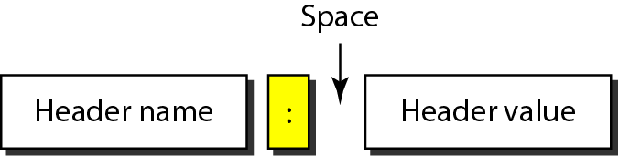
Figure 27.15 Header format
Header: The header exchanges additional information between the client and the server.
The header can consist of one or more header lines.
Each header line has a header name, a colon, a space, and a header value

Slide 47
A header line belongs to one of four categories:
general header
Request header
response header
entity header.
A request message can contain only general, request, and entity headers.
A response message, on the other hand, can contain only general, response, and entity headers.

Slide 48
General header gives general information about the message and can be present in both a request and a response.
Table 27.3 few General headers

Slide 49
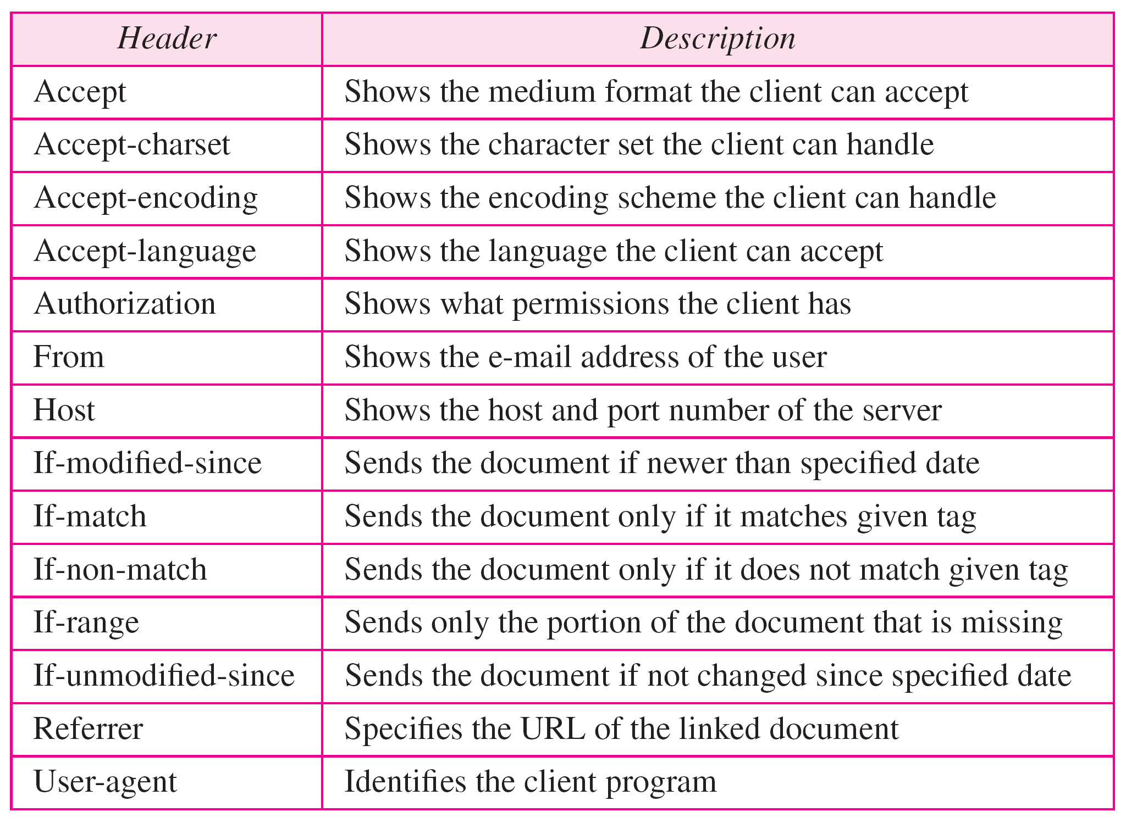
Request header can be present only in a request message. It specifies the client's configuration and the client's preferred document format.
Table 27.4 Request headers

Slide 50
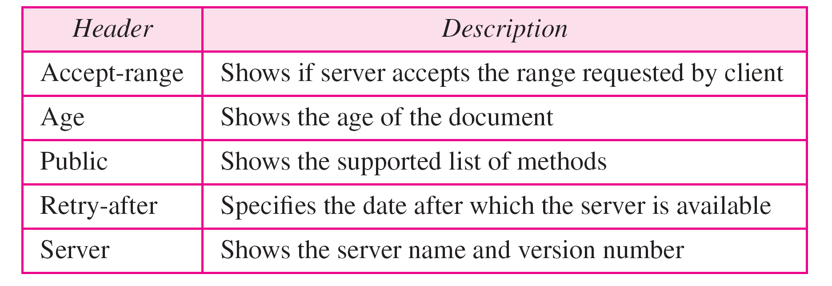
Response header can be present only in a response message.
It specifies the server's configuration and special information about the request.
Table 27.5 Response headers

Slide 51
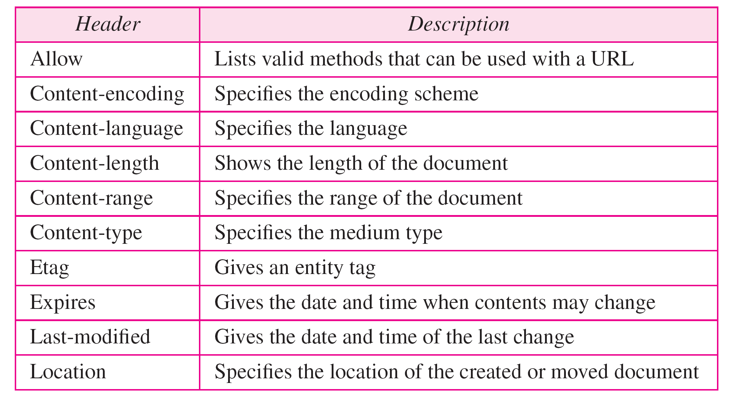
Entity header gives infomation about the body of the document.Although it is mostly present in response messages, some request messages, such as POST or PUT methods, that contain a body also use this type of header.
Table 27.6 Entity headers

Slide 52
Body can be present in a request or response message.
Usually, it contains the document to be sent or received.

Slide 53
Example 27.1
This example retrieves a document. We use the GET method to retrieve an image with the path /usr/bin/image1. The request line shows the method (GET), the URL, and the HTTP version (1.1). The header has two lines that show that the client can accept images in the GIF or JPEG format. The request does not have a body. The response message contains the status line and four lines of header. The header lines define the date, server, MIME version, and length of the document. The body of the document follows the header (see Figure 27.16).

Slide 54
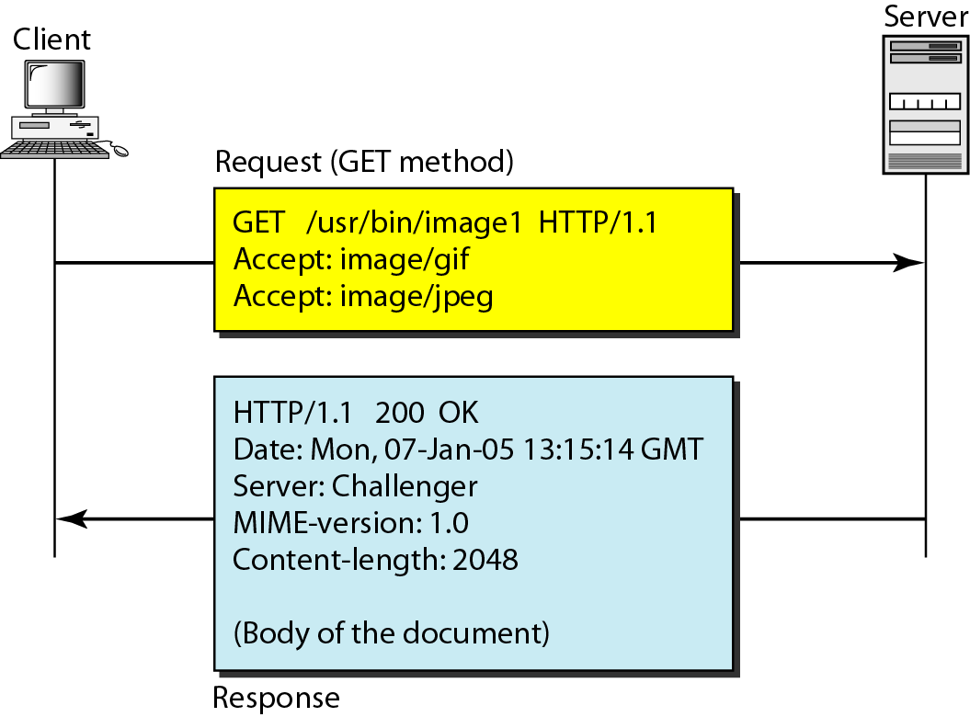
Figure 27.16 Example 27.1

Slide 55
Example 27.2
In this example, the client wants to send data to the server. We use the POST method. The request line shows the method (POST), URL, and HTTP version (1.1). There are four lines of headers. The request body contains the input information. The response message contains the status line and four lines of headers. The created document, which is a CGI document, is included as the body (see Figure 27.17).

Slide 56
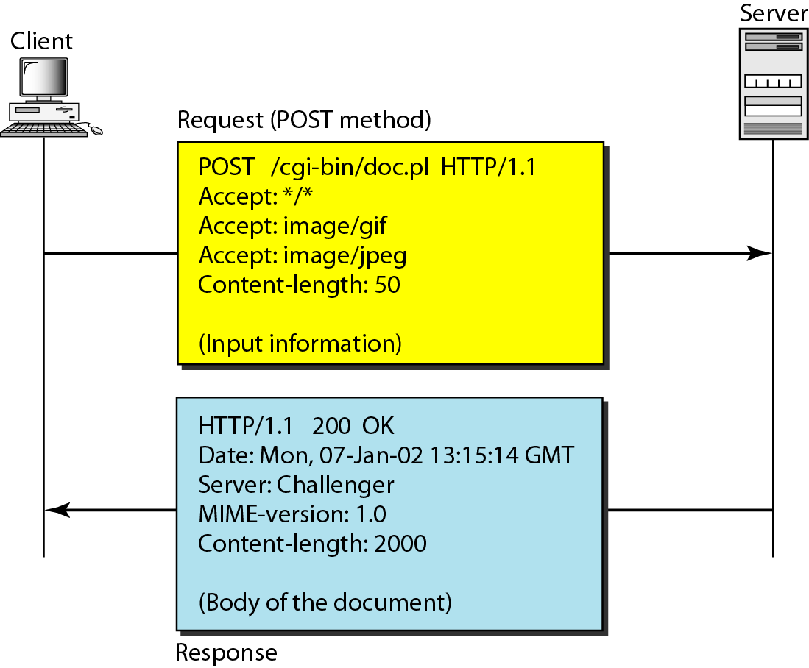
Figure 27.17 Example 27.2

Slide 57
Example 27.3
HTTP uses ASCII characters. A client can directly connect to a server using TELNET, which logs into port 80 (see next slide). The next three lines show that the connection is successful. We then type three lines. The first shows the request line (GET method), the second is the header (defining the host), the third is a blank, terminating the request. The server response is seven lines starting with the status line. The blank line at the end terminates the server response. The file of 14,230 lines is received after the blank line (not shown here). The last line is the output by the client.

Slide 58
Example 27.3 (continued)

Slide 59
Note
HTTP version 1.1 specifies a persistent connection by default.

Slide 60
WAP- WIRELESS APPLICATION PROTOCOL
WAP (Wireless Application Protocol) is a specification for a set of communication protocols to standardize the way that wireless devices, such as cellular telephones and radio transceivers, can be used for Internet access, including e-mail, the World Wide Web, newsgroups, and instant messaging.
WAP was conceived by four companies: Ericsson, Motorola, Nokia, and Unwired Planet (now Phone.com).

Slide 61
The basic aim of WAP is to provide a web-like experience on small portable devices - like mobile phones and PDAs.
An open, global specification that empowers mobile users with wireless devices to easily access and interact with internet information and services instantly.
The wireless industry came up with the idea of WAP. The point of this standard was to show internet contents on wireless clients, like mobile phones.

Slide 62
WAP is an application communication protocol
WAP is used to access services and information
WAP is inherited from Internet standards
WAP is for handheld devices such as mobile phones
WAP is a protocol designed for micro browsers
WAP enables the creating of web applications for mobile devices.
WAP uses the mark-up language WML (not HTML) WML is defined as an XML 1.0 application

Slide 63
Type of devices that use WAP
Handheld digital wireless devices such as mobile phones, pagers, two-way radios, smart phones and communicators -- from low-end to high-end.
The WAP standard describe a protocol suite allowing the interoperability of WAP equipment, and software with different network technologies, such as GSM and CDMA, different types of data like analog or digital.

Slide 64
WAP Architecture Requirements
Leverage existing standards whenever possible
Define a layered, scalable and extensible architecture
Support as many wireless networks as possible
Optimize for narrow-band bearers with high latency
Optimize for efficient use of device resources
Provide support for secure applications and communication

Slide 65
Architecture Overview
WWW programming model is optimized and extended to match characteristics of the wireless environment
Utilizes proxy technology to connect between the wireless domain and WWW

Slide 66
World-Wide Web Model
Web Server
Client
CGI,
Scripts,
Etc.
Request
(URL)
Web
Browser
Response
(Content)
Content

Slide 67
WAP Programming Model
Gateway
Web Server
Client
Encoded
Request
Request
(URL)
CGI,
Scripts,
Etc.
Encoders
And
Decoders
WAE
User
Agent
Encoded
Response
Response
(Content)
Content

Slide 68
WAP Device
- Is used to access WAP applications and content. It might be a PDA, handheld computer.
WAP Client
- Entity that receives content from Internet via a WAP Gateway. This is usually the WAP Browser.
WAP Content/Origin/Application Server
- Element in the network where the information or web/WAP applications resides.

Slide 69
WAP Proxy
- Acts both as a client and as a server in the network.Typically has
Protocol gateway : translates requests from the WAP protocol stack to WWW protocol stack
Content encoders and decoders : translate WAP content into compact encoded formats to reduce the size of data over the network
It allows content and applications to be hosted on standard WWW servers and developed using proven WWW technologies such as CGI scripting

Slide 70
WAP Gateway
- Intermediary element used to connect two different types of network. It receives request directly from the clients as if it actually were the origin server that clients want to receive the information form. The clients are usually unaware that they are speaking to the Gateway.
WAP Browser
Software running on the WAP device that interprets the WAP content arriving from the internet and decides how to display it on WAP device.

Slide 71
WML
WML – Wireless Markup Language formerly called HDML (Handheld Devices Markup Language)
Is a tag language that allows the text portions of Web Pages to be presented on cellular phones and Personal Digital Assistants (PDAs) via wireless access.
WML is used for delivering data to WAP devices, and is HTML- like in its appearance.
An alternative to WML is I-Mode’s cHTML language.

Slide 72
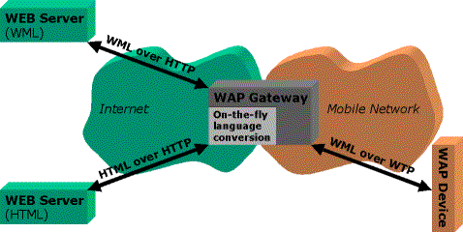
WAP Network Example
Web
Server
WML
WAP
Proxy
Wireless
Network
WML
HTML
WAP
Client
HTML
Filter
WTA
Server

Slide 73
WWW Protocol Stack
HTML
Java Script
HTTP
TLS - SSL
TCP/IP
UDP/IP

Slide 74
Components of WAP Architecture
Application Layer (WAE)
Other Services
And Applications
Session Layer (WSP)
Transaction Layer (WTP)
Security Layer (WTLS)
Transport Layer (WDP)
Bearers :
GSM
CDMA
PHS
IS-136
CDPD
PDC-P
FLEX
Etc…

Slide 75
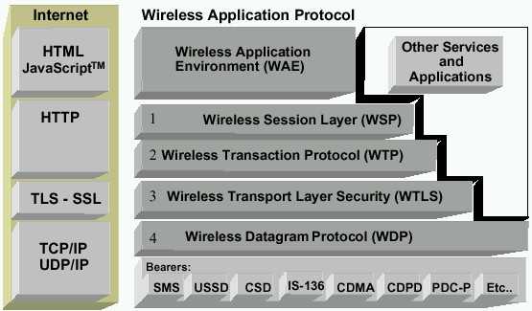
WAP Architecture
MicroBrowser (WML, WMLScript, WTA, WTAI)
Runs on top of WDP
Provided lightweight X-oriented service
Unreliable 1-way request
Reliable 1-way/2-way req./response
Lightweight SSL
Uses WIM/PKI-Cards
Datagram service on different bearers
Convergence betwe- en bearer services
Different Wireless Tech.
Source: WAP Forum

Slide 76
Wireless Application Environment (WAE)
General-purpose application environment based on a combination of WWW and mobile telephony technologies.
It defines the user interface on the phone. It contains WML and WTA (Wireless Telephony Application).
Primary objective – interoperable environment.

Slide 77
Wireless Application Environment (Contd.)
WAE includes a micro-browser (Client software designed to overcome challenges of mobile handheld devices that enables wireless access to services such as Internet information in combination with a suitable network) server environment which provides
WML
WML script
WTA
Content formats

Slide 78
Wireless Session Protocol (WSP)
The WAP session protocol (WSP) layer provides a lightweight session layer to allow efficient exchange of data between applications.
Application layer with a consistent interface for two session services
Connection-oriented service that operates above the transaction layer protocol (WTP)
Connectionless service that operates above a secure or non-secure datagram service (WDP)
Optimized for low-bandwidth bearer networks with long latency

Slide 79
Wireless Transaction Protocol (WTP)
Runs on top of a datagram service
The WAP transaction protocol (WTP) layer provides transaction support, adding reliability to the datagram service provided by WDP.
Light weight transaction-oriented protocol
Three classes of transaction services
Unreliable one-way requests
Reliable one-way requests
Reliable two-way request-reply transactions

Slide 80
Wireless Transport Layer Security (WTLS)
Based on industry-standard Transport Layer Security (TLS) protocol
Optimized for use over narrow-band communication channels
Features:
Data integrity
Privacy
Authentication
Denial-of-service protection

Slide 81
Wireless Datagram Protocol (WDP)
The WAP datagram protocol (WDP) is the Transport layer that sends and receives messages via any available bearer network, including SMS, USSD, CSD, CDPD, IS–136 packet data, and GPRS.
Operates above the data capable bearer services supported by various network types.
Provides a common interface to the upper layer protocols and hence they function independent of the underlying wireless network.

Slide 82
Bearers
Differing levels of quality of service with respect to throughput, error rate, and delays
WAP protocols are designed to compensate for or tolerate these varying levels of service
WDP specification lists the bearers that are supported and techniques used to allow WAP protocols to run over each bearer

Slide 83
Sample WAP Stacks
WAP Technology
WAE
User Agents
Outside of WAP
WAE
Applications over
transactions
WSP/B
Applications over
Datagram Transport
WTP
WTP
No layer
No layer
No layer
WTLS
WTLS
WTLS
UDP
WDP
UDP
WDP
UDP
WDP
IP
Non-IP
IP
Non-IP
IP
Non-IP

Slide 84
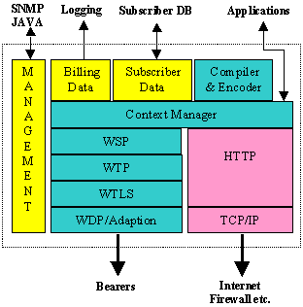
Mobile-Originated Example of WAP Architecture
The request from the mobile device is sent as a URL through the operator's network to the WAP gateway, which is the interface between the operator's network and the Internet as shown in the figure below.

Slide 85
FUTURE OF WAP
Will WAP comply with Third Generation wireless standards?
Yes, WAP has been designed to be as independent as possible from the underlying network technology.
Is WAP necessary with higher bandwidth 3G networks?
Even as bandwidths increase, the cost of that bandwidth does not fall to zero. These costs result from higher power usage in the terminals, higher costs in the radio sections, greater use of RF spectrum, and increased network loading. In addition, the original constraints WAP was designed for -- intermittent coverage, small screens, low power consumption, wide scalability over bearers and devices, and one-handed operation -- are still valid in 3G networks. Finally, we can expect the bandwidth required by application users to steadily increase. Therefore, there is still a need to optimize the device and network resources for wireless environments. We can expect WAP to optimize support for multimedia applications that continue to be relevant.

Slide 86
If WAP is very successful in mass-markets on 2.5G networks, 3G networks may be needed purely for capacity relief.
The reasons to migrate to WAP technology
Network operators are behind WAP
With minimal risk and investment, WAP enables operators to decrease churn, cut costs, and increase revenues by improving existing, value-added services and offering exciting new informational services.
Why are equipment manufacturers interested in WAP?
Being a global open specification suite, WAP has generated the critical mass for manufacturers. This has opened up new product and marketing opportunities in the wireless industry and provides new revenue to participating companies.

Slide 87
The ADVANTAGES that WAP can offer over these other methods are the following:
open standard, vendor independent
network-standard independent
transport mechanism–optimized for wireless data bearers
application downloaded from the server, enabling fast service creation and introduction, as opposed to embedded software

Slide 88
DISADVANTAGES of WAP
Small screens: For web phones, there's an incredibly small viewing area; palmtops are barely better.
Speed of access: few devices have slow access.
Limited or fragmented availability: Wireless web access is sporadic in many areas and entirely unavailable in other areas.
Price: Many technology limitations are being addressed by higher-end devices and services. But the entry price for a good wireless web palmtop with decent display, keyboard.

Slide 89
Summary
WAP provides a markup language and a transport protocol that open the possibilities of the wireless environment and give players from all levels of the industry the opportunity to access an untapped market that is still in its infancy.
The bearer-independent nature of WAP has proved to be a long-awaited breath of fresh air for an industry riddled with multiple proprietary standards that have suffocated the advent of a new wave of mobile-Internet communications. WAP is an enabling technology that, through gateway infrastructure deployed in mobile operator's network, will bridge the gap between the mobile world and the Internet, bringing sophisticated solutions to mobile users, independent of the bearer and network.
Backed by 75 percent of the companies behind the world's mobile telephone market and the huge development potential of WAP, the future for WAP looks bright.

